Slide 1


My Autobiography
I am Shawn Ngala, and I'm excited to share my life story with you. It's a journey filled with ups and downs, lessons learned, and unforgettable moments. Join me as I navigate the tapestry of my experiences.
Shwan ngala

Slide 2

My Early Life in Nakuru, Kenya
1
2
3
A Place of Joy and Laughter
The Beauty of Nature
The Magic of Childhood
My childhood was filled with adventures exploring the wonders of nature. From the stunning views of Lake Nakuru to the lush green landscapes, I was constantly in awe of the beauty surrounding me.
The simple joys of life were magnified in Nakuru. Whether playing with friends in the park or watching the sunset over the lake, every day was a new adventure.
Born and raised in the heart of Nakuru, I was surrounded by a vibrant and welcoming community. The town was a melting pot of cultures, each contributing to its unique charm.

Slide 3
Growing Up With My Family
A Supportive Family
The Joy of Siblinghood
Building a Strong Foundation
My parents, Cynthia and Martin Ouma, provided a loving and supportive environment. They taught me the importance of hard work, resilience, and pursuing my dreams.
As the second born in a family of four, I was fortunate to have siblings who became my closest friends and confidantes. We shared laughter, adventures, and a bond that has endured through the years.
Together, as a family, we built a strong foundation of love, support, and shared values. This foundation has served as a guiding force throughout my life, shaping my character and outlook.

Slide 4

Lessons Learned From My Parents
1
The Value of Hard Work
My parents instilled in me the importance of hard work and dedication. They taught me that success is not handed to you on a silver platter but rather earned through perseverance and commitment.
2
The Power of Education
Education was paramount in my family. My parents emphasized the importance of acquiring knowledge and using it to make a positive impact on the world.
3
The Significance of Values
My parents taught me the importance of integrity, compassion, and respect for others. These values have guided my actions and decisions throughout my life.
4
The Importance of Family
Family was always at the center of my parents' lives. They taught me the value of love, support, and being there for one another through thick and thin.

Slide 5




Navigating the Challenges of Being the Second-Born
Striving for Identity
As the second-born, I often found myself in the middle, trying to find my own space and identity. The constant need to prove myself fueled my determination and ambition.
Building My Own Path
I realized that my unique perspective and experiences were valuable assets. I embraced the challenges of being the middle child, using them as opportunities for growth and self-discovery.
Finding My Voice
I learned to communicate my thoughts and ideas effectively, developing a strong sense of self-awareness and a clear understanding of my own strengths and weaknesses.

Slide 6

Discovering My Passions and Interests
The Power of Reading
Books opened up a world of possibilities, igniting my imagination and sparking my curiosity. I devoured novels, biographies, and everything in between, broadening my horizons and expanding my worldview.
The Art of Expression
Art became a form of expression for me, allowing me to explore my creativity and communicate my emotions. I found solace and joy in painting, drawing, and sculpting, letting my imagination run wild.
The Pursuit of Knowledge
I was drawn to learning new things and expanding my knowledge base. I sought out opportunities to explore diverse fields, immersing myself in different cultures, histories, and sciences.

Slide 7
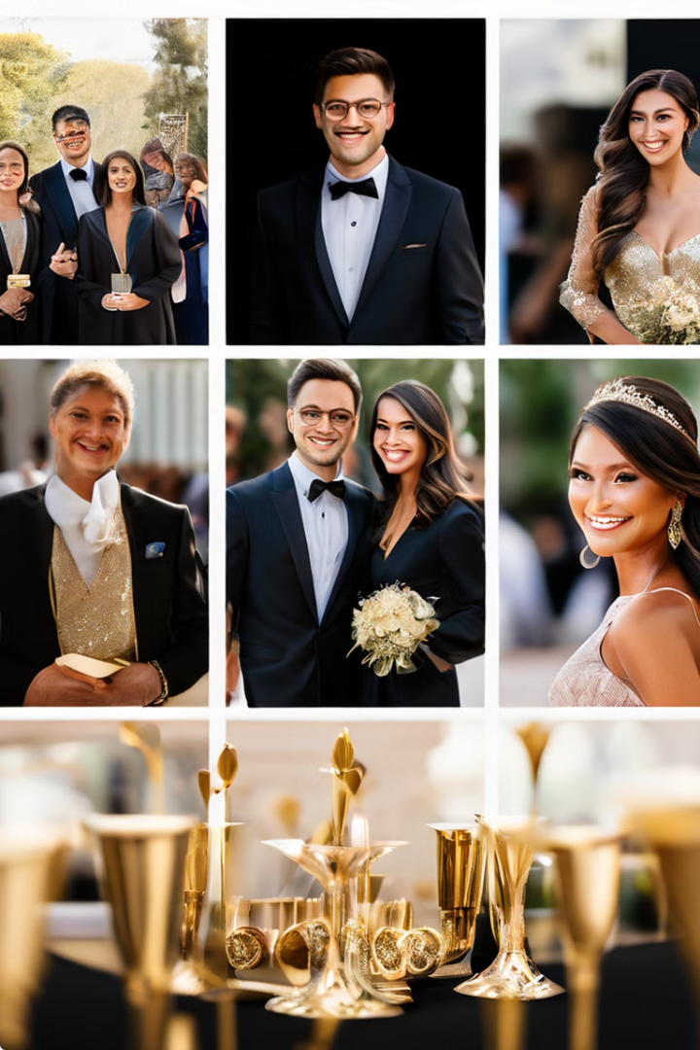
Significant Life Events and Milestones
Event
Description
High School Graduation
Achieving a significant milestone in my academic journey, laying the foundation for my future aspirations.
University Acceptance
Embracing a new chapter in my life, filled with opportunities for growth and discovery, pursuing my passion for [insert specific field of study].
First Job
Gaining valuable experience in the professional world, applying the knowledge and skills I had acquired, contributing to the community.

Slide 8



Looking Towards the Future
Continuous Growth
I remain committed to personal and professional growth, constantly seeking new challenges and opportunities to expand my knowledge and skills.
Giving Back
I believe in the power of giving back to my community, using my skills and resources to make a positive impact on the lives of others.
Embracing New Adventures
I am eager to explore new horizons, embrace new challenges, and continue to learn and grow throughout my life.

